Slide 2
Thomas Haugland Rudfoss
thomas.rudfoss@bouvet.no

Slide 3


React
A JavaScript library for
building user interfaces
- reactjs.org

Slide 4
Agenda
React component core
Props and State
Feature folders
Events and the render loop
Component composition
Loops
Routing
Code Splitting
Memoization
Context
Async data fetching
Error Boundaries

Slide 5
Setup
Create-React-App
npx create-react-app workshop --template typescript
-or-
yarn create create-react-app workshop --template typescript
Change typescript version
npm uninstall typescript
npm install typescript@3.9.5
-or-
yarn remove typescript
yarn add typescript@3.9.5

Slide 6
The React component
Functional vs Class-based
JSX is just JavaScript
Typescript
CSS modules

Slide 7
React app
Settings
App
Header
MainMenu
Content
Router
Home
Profile
About
UserMenu
Login

Slide 8
React app

Slide 9
Props and state
Props: Incomming values (= arguments)
State: Internal values (persisted)
Notes:
Create a simple props component with an internal state. Show why we cannot use primitive consts/let with a button that onClick changes such a property

Slide 10
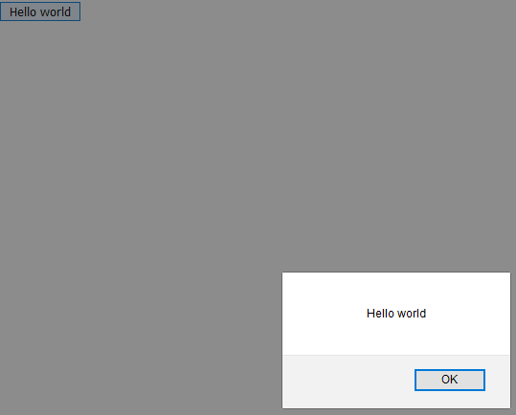
Task – Hello World
Create a component with a single button on it.
When clicked display the text «Hello world» in an alert box.
Bonus: Style it with some modular css.
Notes:
5-10mins

Slide 11
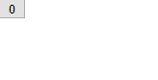
Task - Incrementor
Component with a button that shows a counter
Limit counter through a prop
On click increment a counter by 1
When counter is 2 steps from the limit change the button style and show the message: “You are almost at the limit”
When the counter reaches the limit disable the button
Notes:
10-15mins

Slide 12
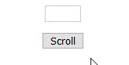
Task - Ticker
Component with a single button and a box for text
Scrolls a message provided through props across the box one character at a time when button is clicked.
The width of the box should be configurable through a prop.
Optional: Make it automatically scroll every 1/3 second.
Notes:
Explain styling using css classes
20mins

Slide 13
Code restructuring
Feature folders
Snippets

Slide 14
React event loop
Browser Event
(React Event)
Our handler
State update
Render component
Compare virtual DOM with live DOM
Update DOM
Notes:
Explain event loop, add for inputs
Ciber kom hit på dag 1

Slide 15
Notes:
Dag 1 ferdig

Slide 16
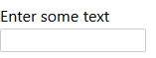
Task – TextInput
Create a proper text input with a label and id
Create some styles for the box i.e.: padding, spacing

Slide 17

Task – RangeInput
Create a range input with an id, label and configurable min and max values.
Give it some styling.
More info: https://developer.mozilla.org/en-US/docs/Web/HTML/Element/input/range

Slide 18
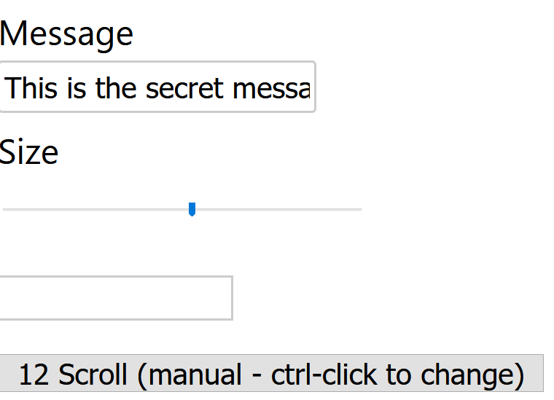
Task – ConnectedTicker
Create a component with a form where the user can input a message and a range.
Use these values to control a Ticker.

Slide 19
Component composition
Allows generic components with placeholders for more functionality
«Render-props»

Slide 20
Task – BigBorder
Create a component that shows its children in a box with a 5px red border.

Slide 21
Task – EitherAOrB
Create a component with a button and two props a and b that each take a JSX.Element
The button should toggle which of the elements are displayed.

Slide 22
Loops
Repeating components
Key-property
More info: https://reactjs.org/docs/reconciliation.html#recursing-on-children
Notes:
Demo a loop by grabbing posts.ts from http://jsonplaceholder.typicode.com/posts

Slide 23
Task – ListMessages
Create a component that lists out the messages from the messages data source.
Add a «data-id» attribute to each element containing the id of the message.

Slide 24
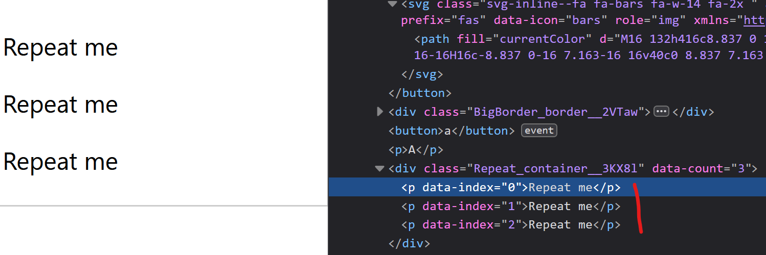
Task – Repeat
Create a component that takes a single JSX.Element as a child and a prop count of type number.
Repeat the child component [count] times and add a prop to each cloned child «data-index» that holds the childs index.
Allow controlling the count-number using a RangeInput.
Hint: Use «React.cloneElement»
Notes:
Denne benytter loops! Introduser det før denne.

Slide 25
Routing
A route is a filter on a url «pattern»
Any component can route
Can extract parameters from the url
Notes:
Split into routes.
Create menu.
Add component displaying parameters from the url (at least two).
Extract path and url from useRouteMatch hook (for future task)

Slide 26
Task – RouteParams
Create a route that contains the message for the ticker as a parameter
Create a route that contains the min and max values for the range input.

Slide 27
Task – Layout
Create a Layout component that has placeholders for a menu, main content and a footer.
Create a separate main menu component with links to some existing routes.
Use Layout component to «lay out» the elements using css.

Slide 28
useEffect
Hook into the react lifecycle.
Used for «side-effects» of rendering a component.

Slide 29
Task – DelayDisplay
Create a component that takes a message as a prop.
Show the message after 5 seconds.
If the component is dismounted log «goodbye» to the console.

Slide 30
Notes:
End of day 2

Slide 31
Task – TodoList
Create a component with a text input and a button
When the button is clicked the text is added to a list and the text input is cleared.
Add a remove button on each individual item that removes the specific item.
Bonus: Pressing enter while the text input has focus also adds the text to the list.
Notes:
Påkrevd av framtige oppgaver

Slide 32
Task – MessageRouter
Req: messages (key/value object)
List message keys as links.
Clicking a link causes the message to display and the url to change to that message key.
Notes:
Messages is a Record<string, string> that contains a url-friendly key in combination with a message.

Slide 33
Test
Running tests with Jest
Component testing with React Testing Library

Slide 34
Code splitting
Load pieces of the app only as needed.
Split the code into smaller chunks for faster loading.

Slide 35
React app

Slide 36
React app

Slide 37
useMemo/useCallback
Remember a computation for later reuse
Avoid doing unnecessary work
Notes:
Demo a component that reuses precomputed value. (create simulateHeavySync)

Slide 38
Task – HeavyForm
Req: showMessage (simulate heavy calculation)
Create a form with an input for:
Firstname
Lastname
Age (range) 5-95
Create a secret message that should only be visible if showMessage returns true
Memoize the operation so that it does not have to run on every state change.

Slide 39
Context
«Pass props to any decendant»
Component is aware of changes and updates accordingly

Slide 40
Task – UserContext
Create a context that provides a name and email
Show the name in one other component and the email in another.

Slide 41
Task – ContextTodos
Create a context that provides the list of «todo» items.
Show the number of todos in the main menu next to a link to the route displaying the todo list.
Notes:
Requires the todo task

Slide 42
Context vs Redux
Context elevates state beoynd the parent component.
Redux elevates state all the way outside of React.
Redux requires some boilerplate to get started.
Context plays with the existing principles in React.
useReducer provides a similar pattern to Redux within React.

Slide 43
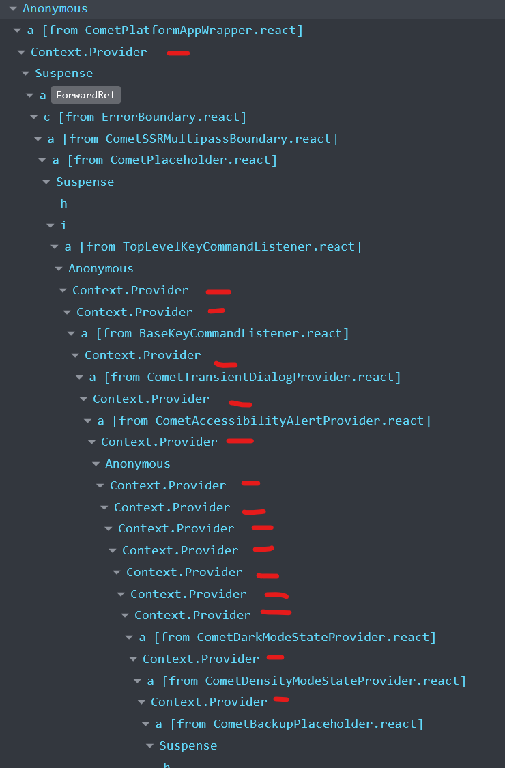
Context Performance @ Facebook
5
5
Notes:
Data fra 09.10.2020

Slide 44
Async data
Getting data from another server
Show loading state in React

Slide 45
Task – ListPosts
Create a version of ListPosts that loads posts asynchronously.
Show a loading message while waiting.
Bonus: Allow sorting posts ascending or descending by adding /asc or /desc at the end of the url
API: http://jsonplaceholder.typicode.com/posts

Slide 46
Task – ListPostsByUser
Create an component that uses the url to determine the users id and then lists posts by that user.
No need to sort this one.
API: http://jsonplaceholder.typicode.com/users/[id]/posts

Slide 47
Task – ListUsers
Create a component that lists all users.
Add a link next to each user that takes you to a list of their posts.
API: http://jsonplaceholder.typicode.com/users

Slide 48
Error Boundary
Catches errors thrown by components in the react tree
«Last resort»

Slide 49

Summary – Component
Props
Context
Component
State
JSX
Notes:
Component
JSX
Pass it to react
State
Props
Context

Slide 50
Summary – Component tree
Props
Props
Props
Props
Props
Props
Props
Props

Slide 51
Summary – Routing

Slide 52
Summary – Code splitting

Slide 53
Summary – Context

